Slide 1

AI50 Project
Patrolling problem
• Coordinating multiple agents to navigate an
environment represented as a graph
• Ensuring that all strategic zones or points are
visited regularly
• Visiting strategic locations in a region at regular
intervals.

Slide 2
AI50 Patrolling problem
Context
Objective functions
Constraints
Interface
Monobase
Realtime algo
Random
Runtime
Path algo
Multi ACO
Multi ACO Cluster
Multibase
Base location
Algo genetic
Cluster
Path algo
Multi ACO
Multi ACO Cluster
Results
Context : Military base
1
Reinforced Security
2
Complex environment
The military base requires constant surveillance to ensure the safety of the site and personnel.
The base has many obstacles and risk areas, making the movement of agents more difficult.
3
Critical Optimization
Patrol routes must be carefully planned to effectively cover the entire area.

Slide 3
AI50 Patrolling problem
Context
Objective functions
Constraints
Interface
Monobase
Realtime algo
Random
Runtime
Path algo
Multi ACO
Multi ACO Cluster
Multibase
Base location
Algo genetic
Cluster
Path algo
Multi ACO
Multi ACO Cluster
Results
Objective function
Our objective function is to minimize idleness across the graph G.
The idleness of a node at time , denoted , is defined as the time elapsed since the last visit by an agent to that node.
Two criteria :
Worst Idleness (WI) :
Average Idleness (AI) :

Slide 4
AI50 Patrolling problem
Context
Objective functions
Constraints
Interface
Monobase
Realtime algo
Random
Runtime
Path algo
Multi ACO
Multi ACO Cluster
Multibase
Base location
Algo genetic
Cluster
Path algo
Multi ACO
Multi ACO Cluster
Results
Constraints
In the context of patrolling a military base, agents must contend with various constraints that directly impact their ability to conduct effective and continuous patrols.
Limited number of agents
Mandatory return to starting node
Weather
Multi/Mono Base
Map choice

Slide 5
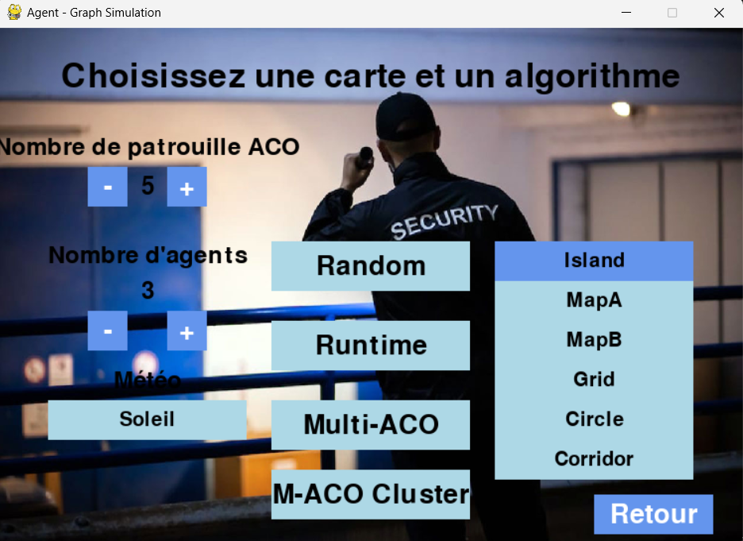
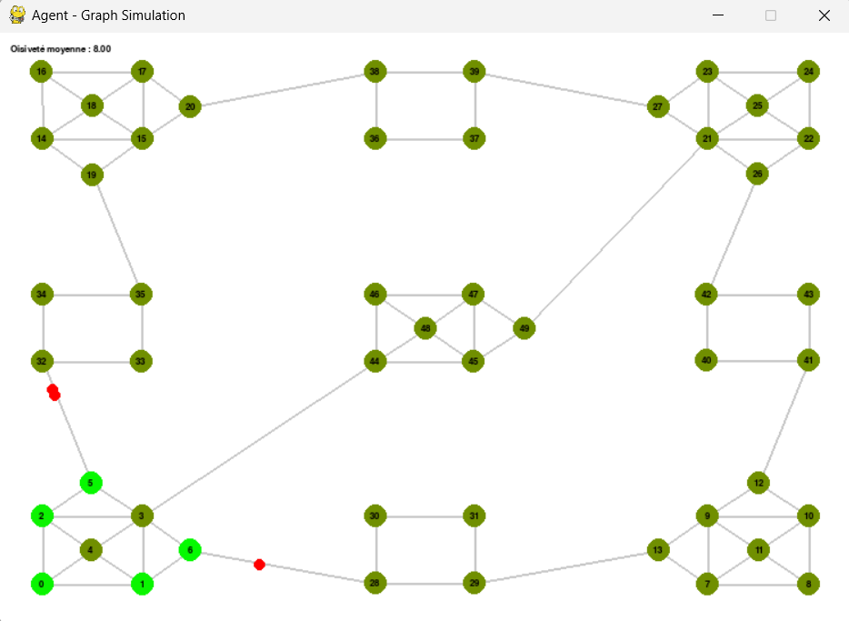
AI50 Patrolling problem
Context
Objective functions
Constraints
Interface
Monobase
Realtime algo
Random
Runtime
Path algo
Multi ACO
Multi ACO Cluster
Multibase
Base location
Algo genetic
Cluster
Path algo
Multi ACO
Multi ACO Cluster
Results
Interface
Here's the interface layout for our two main windows, one for setting the simulation parameters and the other for displaying the simulation:

Slide 6
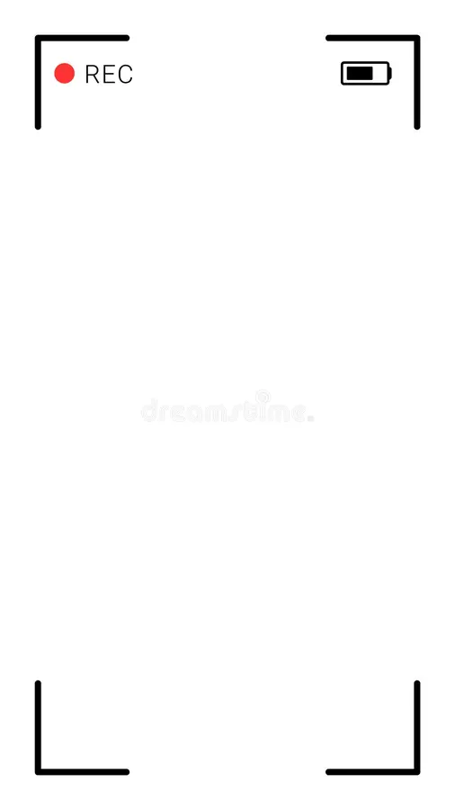
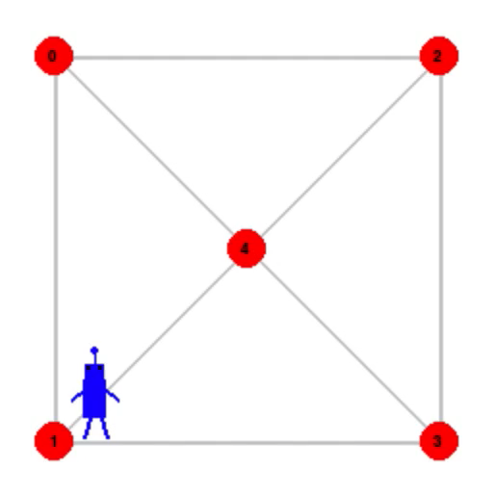
AI50 Patrolling problem
Context
Objective functions
Constraints
Interface
Monobase
Realtime algo
Random
Runtime
Path algo
Multi ACO
Multi ACO Cluster
Multibase
Base location
Algo genetic
Cluster
Path algo
Multi ACO
Multi ACO Cluster
Results
Random Algorithm
1
Definition
The random Algorithm is the simplest algorithm, as each agent chooses its next node randomly among the ones adjacents.
2
Advantages
The easiest algorithm to code
3
Disadvantages
Not optimal, no strategy, neither communication between agents.

Slide 7
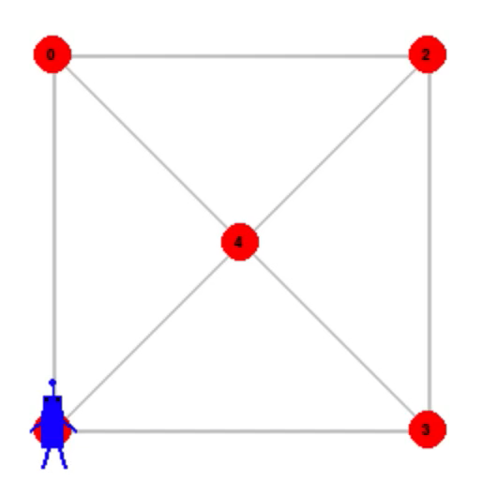
AI50 Patrolling problem
Context
Objective functions
Constraints
Interface
Monobase
Realtime algo
Random
Runtime
Path algo
Multi ACO
Multi ACO Cluster
Multibase
Base location
Algo genetic
Cluster
Path algo
Multi ACO
Multi ACO Cluster
Results
RunTime
Reactif behavior by default
1
The agent moves to the neighboring node accessible with the greatest idleness.
In case of equal idleness, random choice among neighbors
2
Cognitif Behavior probabilistic
With probability p, the agent enters cognitive mode, enabling it to make decisions beyond its neighborhood. Global analysis of the graph to find the node with the worst idleness. If the node is close to the agent, Dijkstra is used to plan a path; otherwise, the task is transferred to the nearest agent.
3
Back to reactif mode
After a cognitive task, the agent reverts to its reactive behavior to guarantee continuous local monitoring.

Slide 8
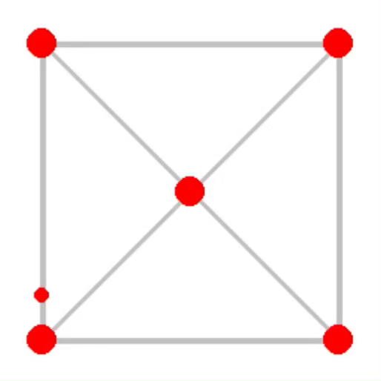
AI50 Patrolling problem
Context
Objective functions
Constraints
Interface
Monobase
Realtime algo
Random
Runtime
Path algo
Multi ACO
Multi ACO Cluster
Multibase
Base location
Algo genetic
Cluster
Path algo
Multi ACO
Multi ACO Cluster
Results
Multi ACO: 1 agent
1
Definition
This approach is inspired by the behavior of ants, where agents (or "ants") deposit pheromones on paths they travel and prioritize paths that have not been visited recently.
2
Advantages
The ACO approach dynamically balances exploration and exploitation of paths, adapting over time to minimize idleness across the graph.
3
Disadvantages
Requires repeated iterations to converge to an optimal solution and may be computationally intensive, especially on larger graphs.

Slide 9
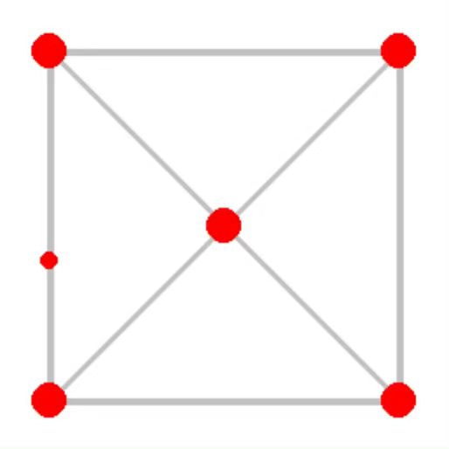
AI50 Patrolling problem
Context
Objective functions
Constraints
Interface
Monobase
Realtime algo
Random
Runtime
Path algo
Multi ACO
Multi ACO Cluster
Multibase
Base location
Algo genetic
Cluster
Path algo
Multi ACO
Multi ACO Cluster
Results
Multi ACO
1
Definition
This approach is the ACO algorithm, but the goal of this one is, instead of giving one optimal way to follow, x different ways apply to x agents.
2
Advantages
The ACO used for the Multi agent systems takes into account the nodes seen by the other agents for each agents, improving the optimality.
3
Disadvantages
Requires repeated iterations to converge to an optimal solution and may be computationally intensive, especially on larger graphs.

Slide 10
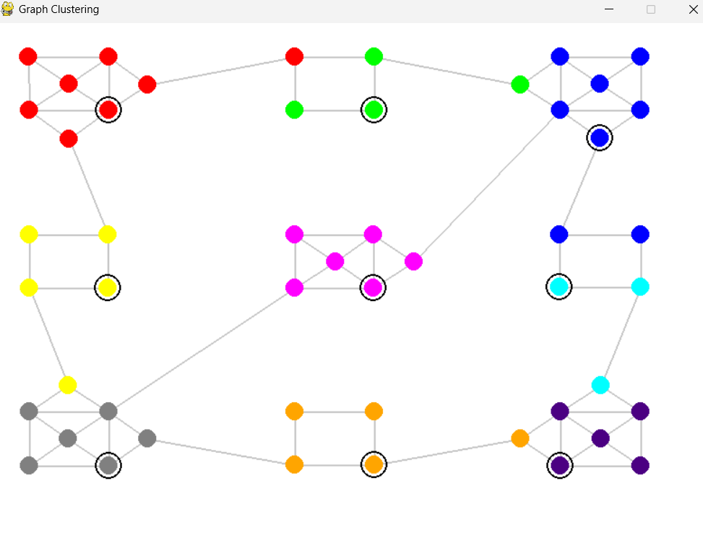
AI50 Patrolling problem
Context
Objective functions
Constraints
Interface
Monobase
Realtime algo
Random
Runtime
Path algo
Multi ACO
Multi ACO Cluster
Multibase
Base location
Algo genetic
Cluster
Path algo
Multi ACO
Multi ACO Cluster
Results
Multi ACO Cluster
Overview
The hybrid algorithm combines ACO and Clustering to address the Multi-Agent Patrolling Problem (MAPP). The goal is to optimize patrolling strategies, ensuring that all critical zones are visited regularly while minimizing idle times.
Random
Reactive agents
Cognitive agents
Process
Upgrade : Reactive and Cognitive
The graph is weighted based on the positions of nodes and edges.
Nodes are grouped into clusters using the K-Means algorithm.
The node closest to node 0 becomes the entry point of each cluster.
The path from node 0 to the entry point is calculated
Nodes within each cluster are extracted to build a specific subgraph and distance matrix.
The ACO algorithm is used to find the optimal path within the cluster.
Agents calculate the return path to node 0.
ACO Single Agent
ACO Multi Agent
Evolutionary Algorithm
Benefits
Clustering
Flexibility: Handles heterogeneous agents with varying speeds and priorities.
Efficiency: optimal solution, balancing exploration and exploitation.
Scalability: Can be adapted for larger, more complex environments with multiple agents.

Slide 11
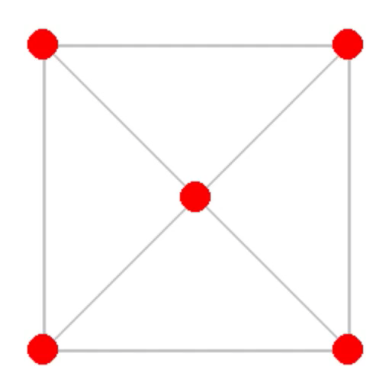
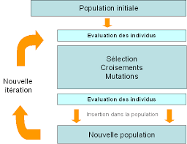
AI50 Patrolling problem
Context
Objective functions
Constraints
Interface
Monobase
Realtime algo
Random
Runtime
Path algo
Multi ACO
Multi ACO Cluster
Multibase
Base location
Algo genetic
Cluster
Path algo
Multi ACO
Multi ACO Cluster
Results
Algo genetic
Process
  Initialize population of solutions (agent distributions).
  Evaluate solutions based on distance and coverage.
  Select, crossover, and mutate solutions to generate better configurations.
  Repeat for multiple generations until an optimal agent layout is achieved.

Slide 12
AI50 Patrolling problem
Context
Objective functions
Constraints
Interface
Monobase
Realtime algo
Random
Runtime
Path algo
Multi ACO
Multi ACO Cluster
Multibase
Base location
Algo genetic
Cluster
Path algo
Multi ACO
Multi ACO Cluster
Results
Cluster
Why K-means?
Random
K-Means efficiently divides nodes into clusters by minimizing the distance between nodes within each cluster. It helps ensure clusters have balanced total weights, reducing the workload disparity among agents.
Process:
Random Initialization: Clusters are initially assigned randomly.
Weight Calculation: Total weights (sum of weighted distances) are calculated for each cluster.
Connectivity Check: Each cluster's connectivity is verified.
Weight Evaluation: The relative difference between the largest and smallest cluster weights is evaluated.
Iterative Adjustment: Clusters are adjusted iteratively until the relative difference is below a specific tolerance.
Reactive agents
Cognitive agents
Upgrade : Reactive and Cognitive
ACO Single Agent
ACO Multi Agent
Why balance cluster?
Evolutionary Algorithm
If one cluster is significantly larger than the others, an agent will have to travel a much longer distance compared to other agents. The goal is to balance the workload among all agents to ensure efficiency.
Clustering

Slide 13
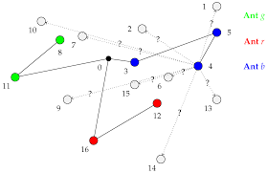
AI50 Patrolling problem
Context
Objective functions
Constraints
Interface
Monobase
Realtime algo
Random
Runtime
Path algo
Multi ACO
Multi ACO Cluster
Multibase
Base location
Algo genetic
Cluster
Path algo
Multi ACO
Multi ACO Cluster
Results
Multi ACO
Overview
The hybrid algorithm combines ACO and EA to address the Multi-Agent Patrolling Problem (MAPP). The goal is to optimize patrolling strategies, ensuring that all critical zones are visited regularly while minimizing idle times.
Benefits
Flexibility: Handles heterogeneous agents with varying speeds and priorities.
Efficiency: optimal solution, balancing exploration and exploitation.
Scalability: Can be adapted for larger, more complex environments with multiple agents.

Slide 14
AI50 Patrolling problem
Context
Objective functions
Constraints
Interface
Monobase
Realtime algo
Random
Runtime
Path algo
Multi ACO
Multi ACO Cluster
Multibase
Base location
Algo genetic
Cluster
Path algo
Multi ACO
Multi ACO Cluster
Results
Multi ACO Cluster
Overview
The hybrid algorithm combines ACO and Clustering to address the Multi-Agent Patrolling Problem (MAPP). The goal is to optimize patrolling strategies, ensuring that all critical zones are visited regularly while minimizing idle times.
Random
Reactive agents
Cognitive agents
Process
Upgrade : Reactive and Cognitive
The graph is weighted based on the positions of nodes and edges.
Nodes are grouped into clusters using the K-Means algorithm, with barycenters calculated.
Nodes within each cluster are extracted to build a specific subgraph and distance matrix.
The ACO algorithm is used to find the optimal path within the cluster.
ACO Single Agent
ACO Multi Agent
Benefits
Evolutionary Algorithm
Flexibility: Handles heterogeneous agents with varying speeds and priorities.
Efficiency: optimal solution, balancing exploration and exploitation.
Scalability: Can be adapted for larger, more complex environments with multiple agents.
Clustering

Slide 15
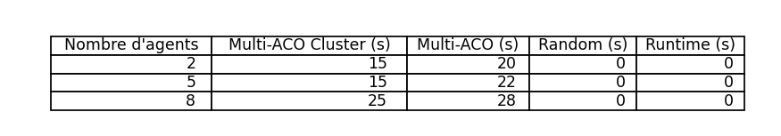
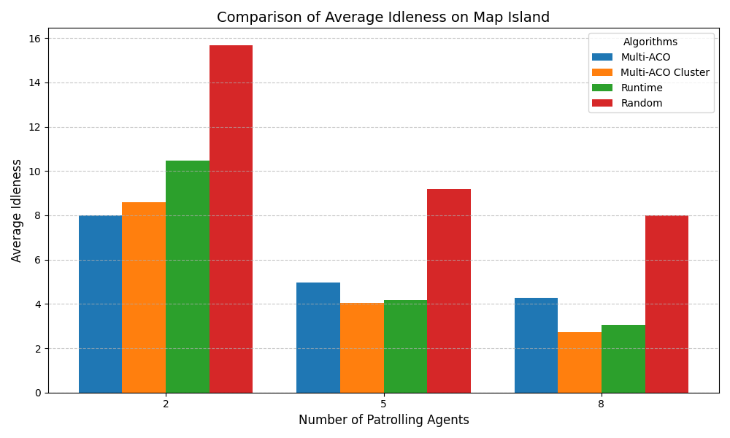
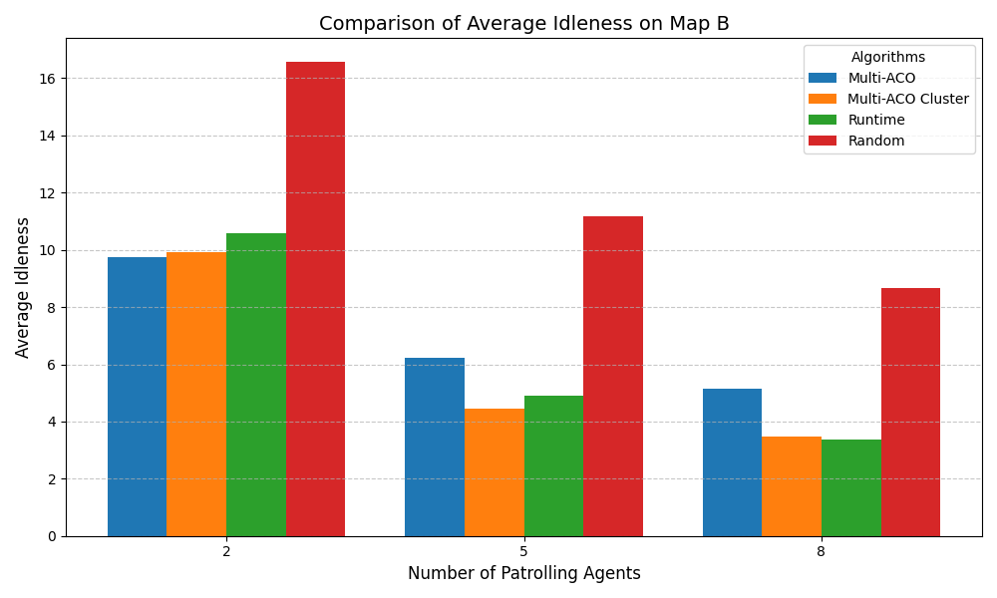
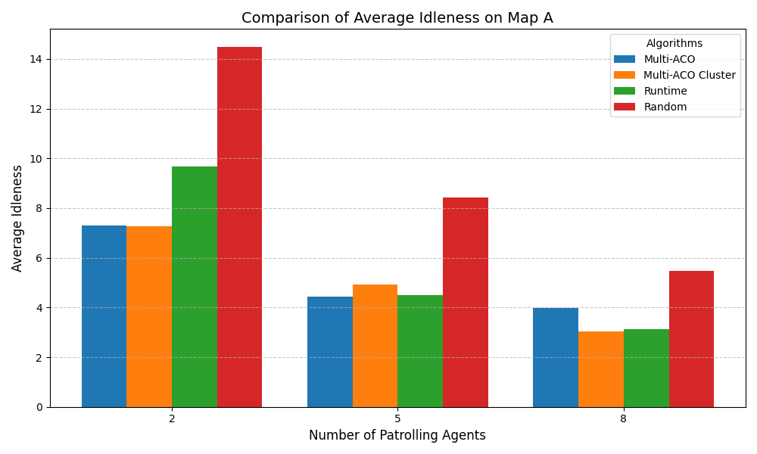
AI50 Patrolling problem
Context
Objective functions
Constraints
Interface
Monobase
Realtime algo
Random
Runtime
Path algo
Multi ACO
Multi ACO Cluster
Multibase
Base location
Algo genetic
Cluster
Path algo
Multi ACO
Multi ACO Cluster
Results
Results

Slide 16
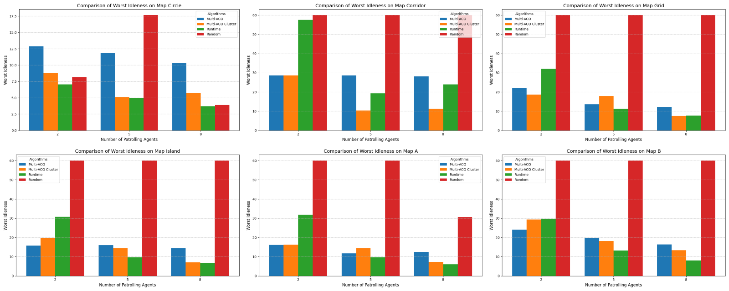
AI50 Patrolling problem
Context
Objective functions
Constraints
Interface
Monobase
Realtime algo
Random
Runtime
Path algo
Multi ACO
Multi ACO Cluster
Multibase
Base location
Algo genetic
Cluster
Path algo
Multi ACO
Multi ACO Cluster
Results
Results

Slide 17
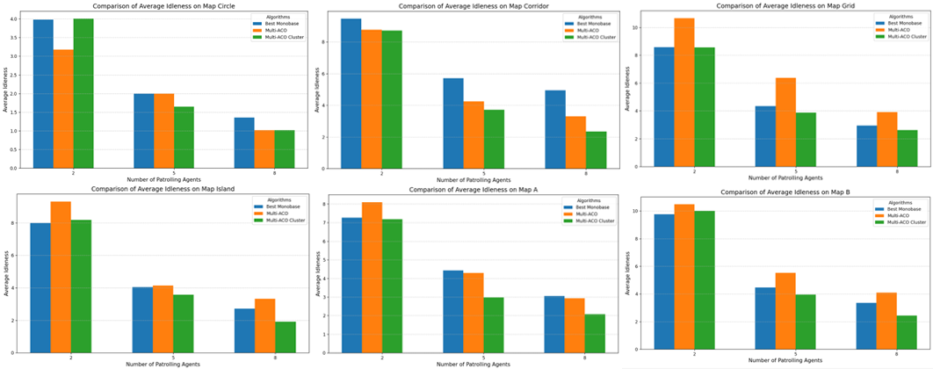
AI50 Patrolling problem
Context
Objective functions
Constraints
Interface
Monobase
Realtime algo
Random
Runtime
Path algo
Multi ACO
Multi ACO Cluster
Multibase
Base location
Algo genetic
Cluster
Path algo
Multi ACO
Multi ACO Cluster
Results
Results

